Slide 1
System Architecture
SA group:
Pan Tao
Li Yang
Zhou Liangxiao
Pan Xin

Slide 2
Introduction
Objective
A web system to promote learners’ learning.
Learning Workflow
Distributed
DLWS:Distributed Learning Workflow System

Slide 3
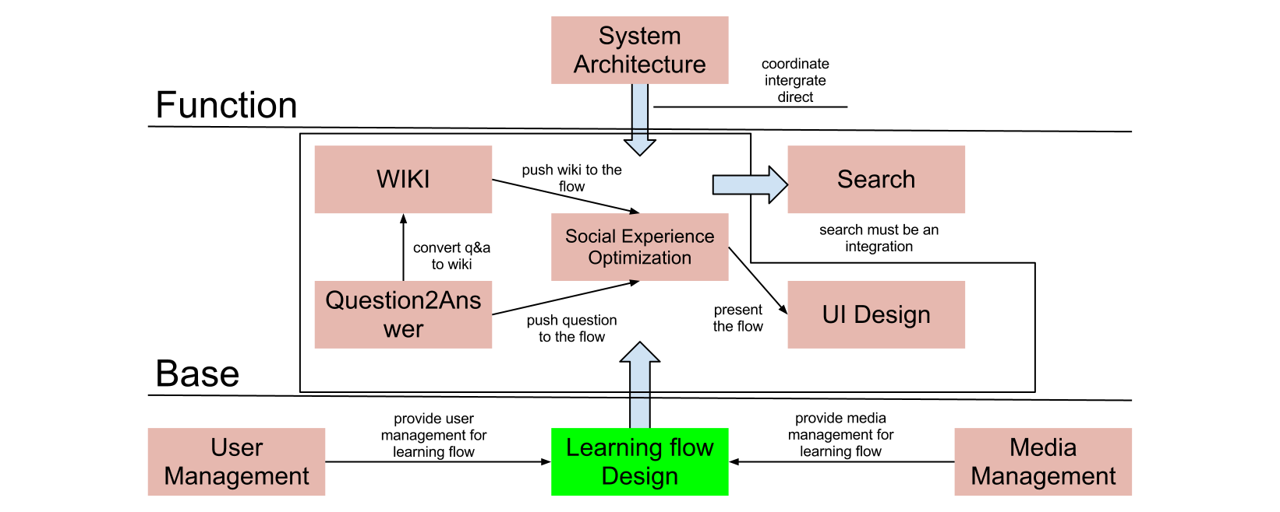
Learning Workflow

Slide 4
Methodology
Naming
Classifi-cation
Validation
Mapping

Slide 5
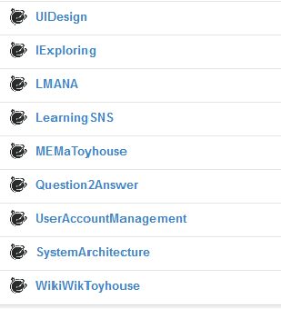
Workflow Unit
SNS
Serialization
Post
River
Process
UI
Learners
Q2A
Media
Wiki
Standardize
MEMa
Search
UAM
UI

Slide 6
Dilemma
Complexity
Socio-technical
Project Management

Slide 7
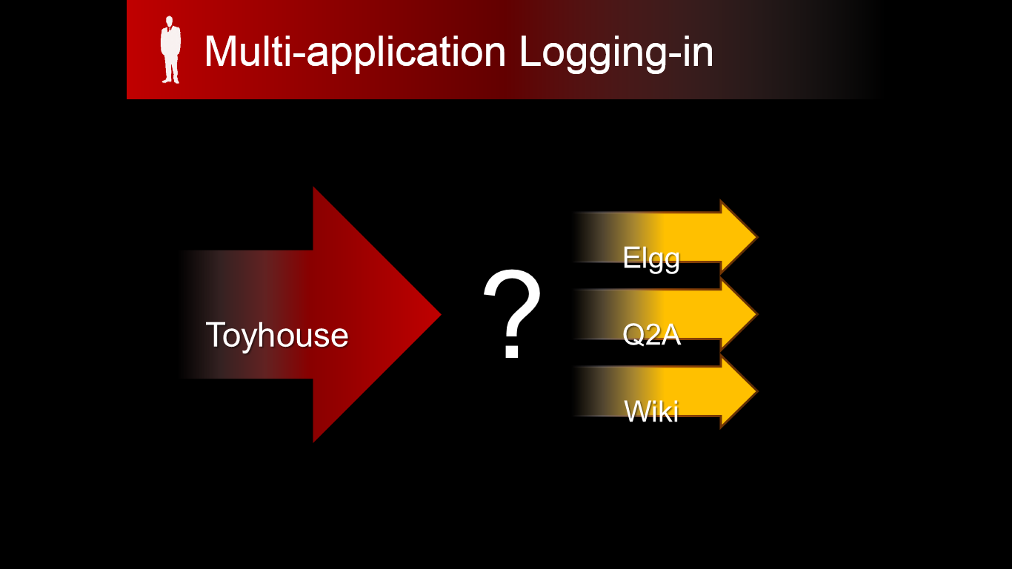
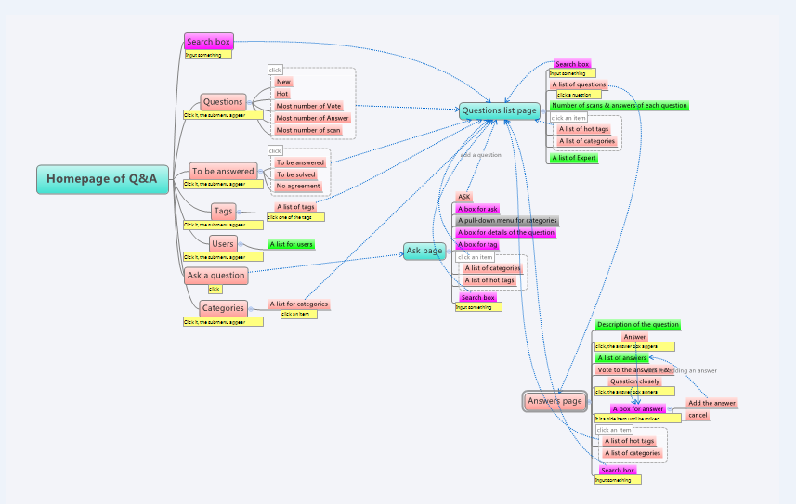


Complexity
Dilemma
Integration
Heterogeneity(异质性)
Homogeneity(同质性)

Slide 8
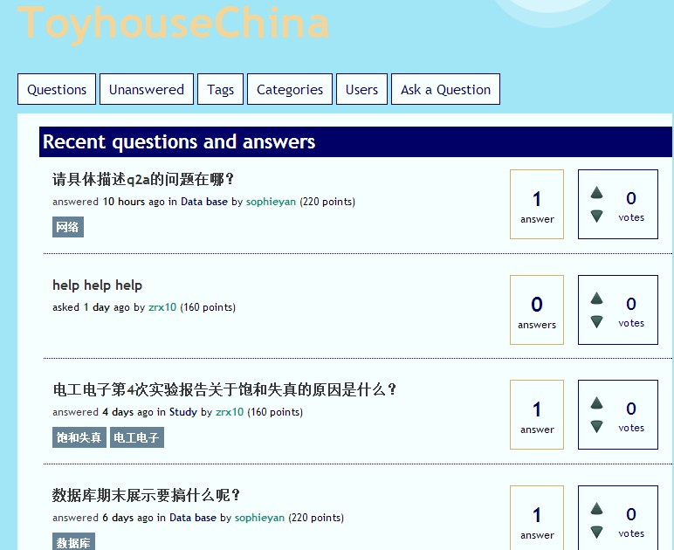
Dilemma
Socio-technical
Product vs. Project
Need
Socio-technical system
Learners or stakeholders
product
Services
Need
Support
Need
project
Designers or technicians
Ideas or codes

Slide 9
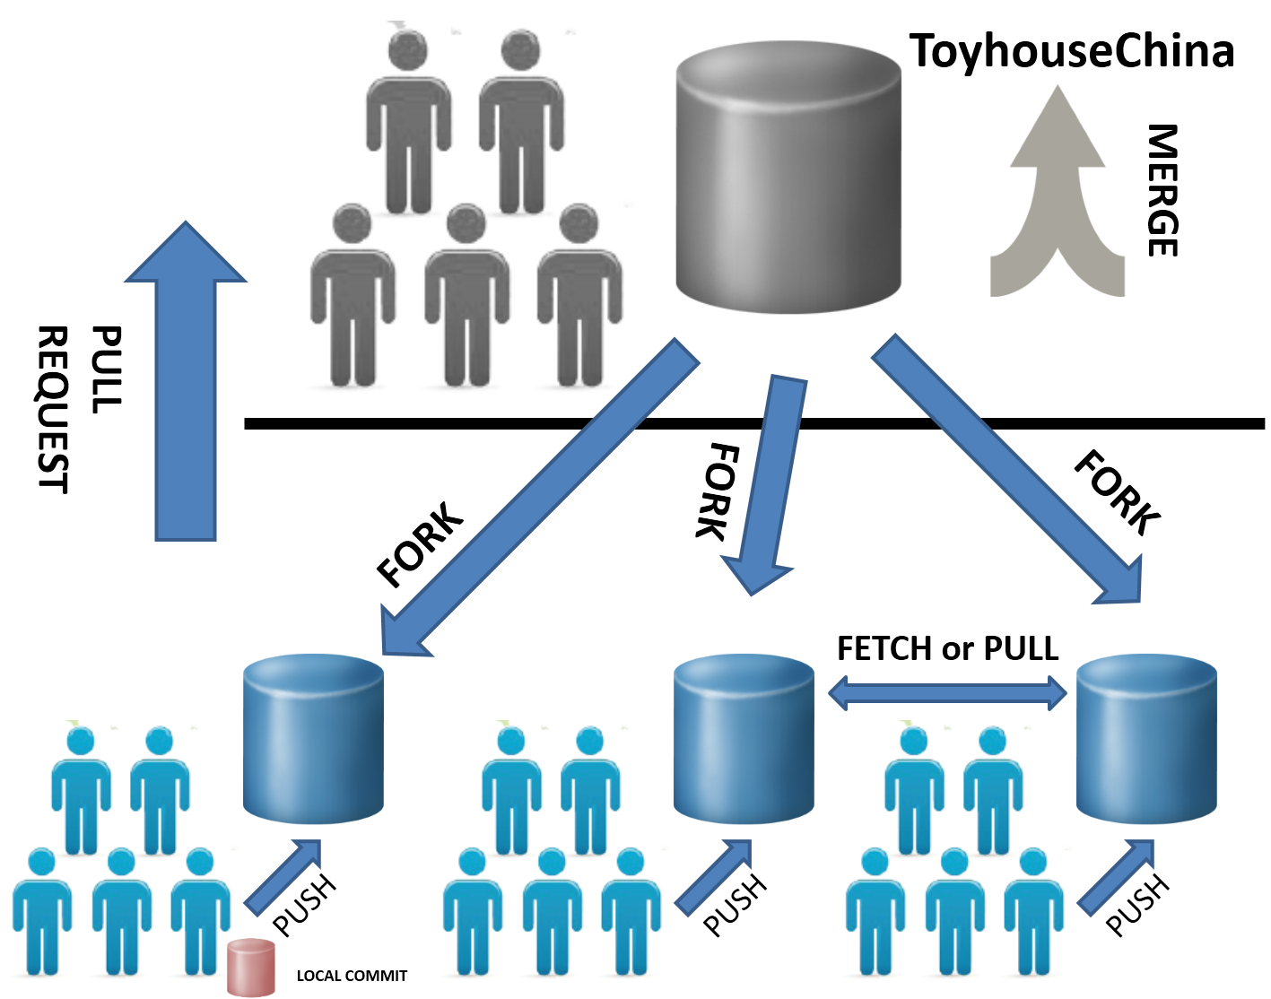
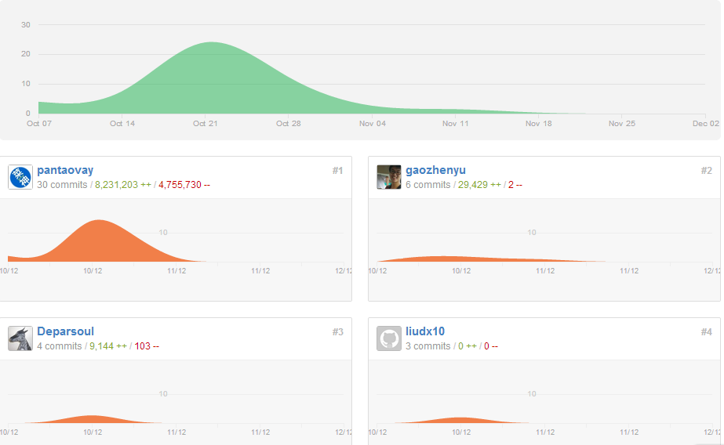
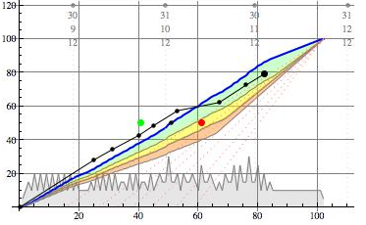
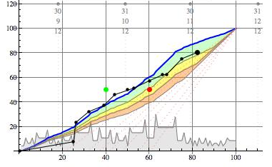
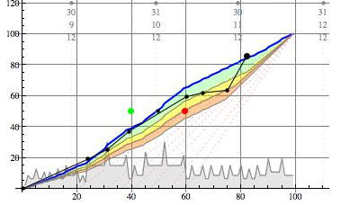
Dilemma
Project Management
GitHub
Code, task and contribution management
DPC
Progress management
IExploring
Q&A
L MANA

Slide 10
System architecture
“Architecture” denotes the stable properties of the system.
“A Meta Language for System Architecutre”
Benjamin Koo, 2001

Slide 11
Stable properties for DLWS
Objective
A web system to promote learners’ learning.
Learning Workflow
Distributed Architecture

Slide 12
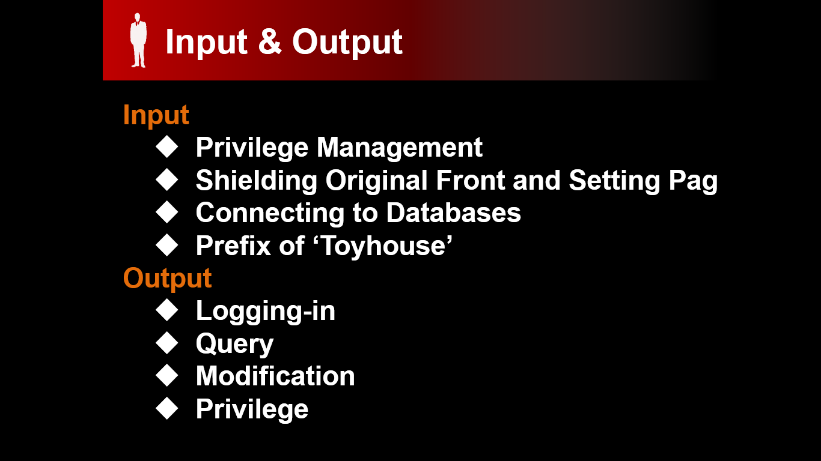
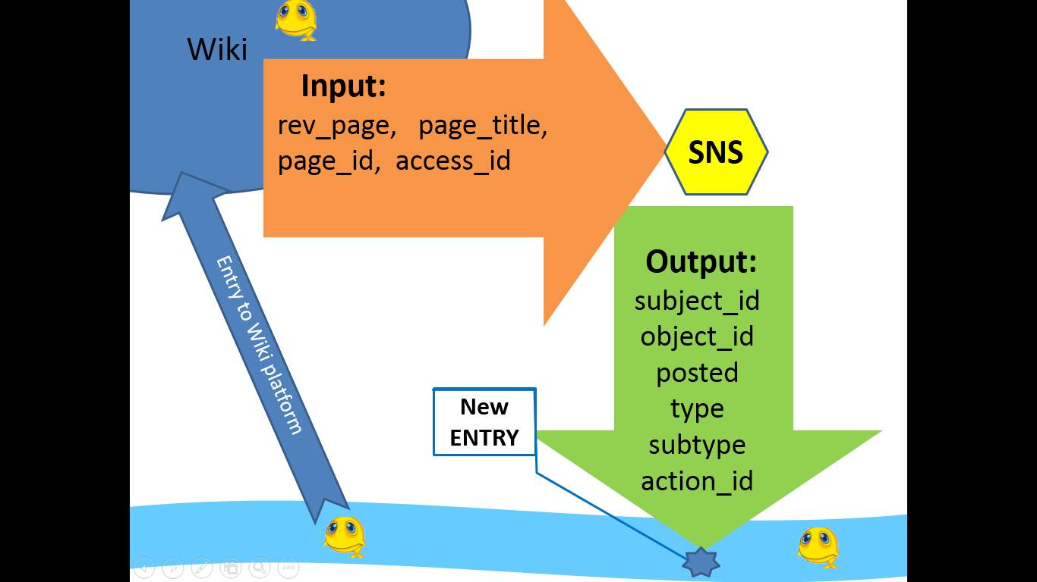
Principles
Thinking with a systematic approach
A pattern is needed here.
Reasoning according to an architecture paradigm
A description is needed here.

Slide 13
Workflow-oriented Architecture

Slide 14
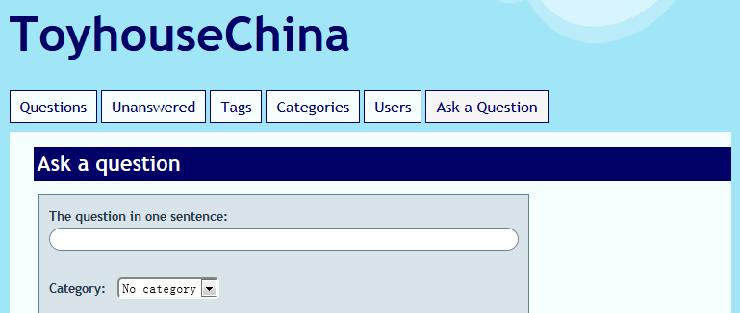
Workflow-oriented Architecture
Workflow is a sequence of operations.
Workflow unit is a sequence of operations that accomplishes a work.
A system can be described by workflow units.

Slide 15
Workflow-oriented Architecture(cont’d)
Treat any workflow unit as a whole.
Ignore the implementation details.
Each workflow unit communicates with each other only by operation interfaces.
Workflow units must be loosely coupled.

Slide 16
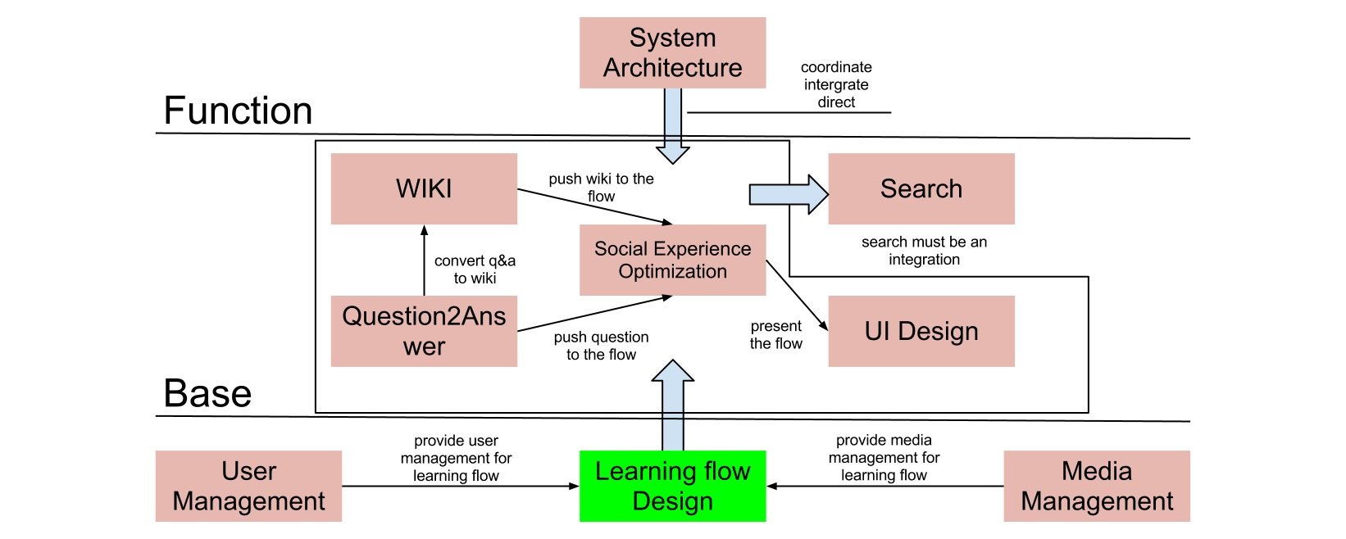
Learning Workflow

Slide 17
Service-oriented Architecture is needed!

Slide 18
Mandates of our project
Give service interfaces
Query_friend ($username1,$username2)
set_friend ($username1,$username2)
remove_friend ($username1,$username2)
Use service interfaces
Only service interfaces
Notes:
All teams will henceforth expose their data and functionality through service interfaces.
Teams must communicate with each other through these interfaces.
3. The only communication allowed is via service interface calls over the network.Direct linking, direct reads of another team’s data store, shared-memory model, back-doors whatsoever are forbidden.
Give service interfaces
Use service interfaces
Only service interfaces

Slide 19
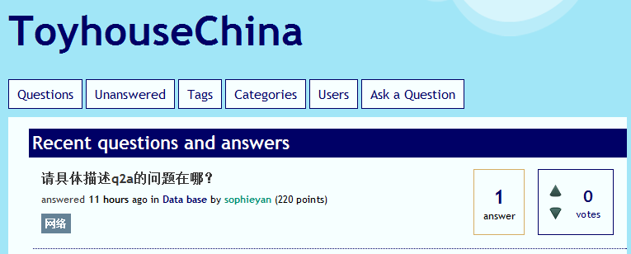

SOA(Service-oriented Architecture)
For our project based on SOA, our service
is self-contained
is a distributed component
has a published interface
stresses interoperability
is loosely coupled
Notes:
1.The service is highly modular and can be independently deployed
2.The service is available over the network and accessible through a name or locator other than the absolute network address
3.Users of the service only need to see the interface and can be oblivious to implementation details.
4.Service users and provider can use different implementation languages and platforms
loosely coupled

Slide 20
The Basic Components of SOA
Service user
Service provider
Elements invoke services provided by others
Elements offer services to be used by others
Notes:
There is no absolute boundary between users and providers. Take IExploring for example, when others want to explore something, Iexploring is a provider but when it wants to ask a question on Q&A platform, it becomes service user.

Slide 21
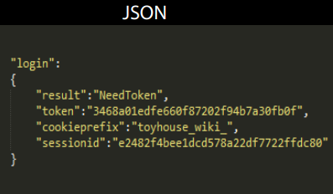
Implementation
UDDI
Registry
WSDL
JSON
Service user
Service provider
SOAP
Notes:
It has an interface described in a machine-processable format (specifically Web Services Description Language, known by the acronym WSDL). Other systems interact with the Web service in a manner prescribed by its description using SOAP messages, typically conveyed using HTTP with an XML serialization in conjunction with other Web-related standards.
大致来说，web服务提供者使用WSDL描述所提供的服务，并将这一描述传递给Web服务的注册服务器。注册服务器依据该服务的WSDL描述，根据UDDI规范更新服务目录，同时将该服务在互联网上发布。用户在使用web服务前，必须先向注册服务器发出请求，由服务器返回web服务提供者的地址和服务接口信息，再使用SOAP协议与web服务提供者建立连接和通信。

Slide 22
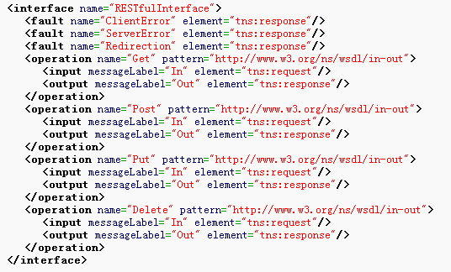
WSDL(Web Services Description Language)
The Web Services Description Language is an
XML-based language that is used for describing the functionality offered by a Web service.
Notes:
Web服务描述语言

Slide 23
UDDI(Universal Description Discovery and Integration)
UDDI is a platform-independent , XML-based registry by which businesses worldwide can list themselves on the Internet , and a mechanism to register and locate web service applications.
Notes:
统一描述，发现和集成协议

Slide 24
SOAP(Simple Object Access Protocol)
SOAP is a protocol specification for exchanging structured information in the implementation of Web Services in computer networks.
Notes:
简单对象访问协议
Communication approach
define the SOAP communication between services user and providers.
It relies on (XML) for its message format, and usually relies on other Application Layer protocols, most notably (HTTP) and (SMTP), for message negotiation and transmission.
It’s a protocol between service user and provider.

Slide 25
Challenges
SOA performance is negatively impacted
Security
Testing
High reliability
Notes:
1.(1)SOA enables distributed computing, and the need to communicate over a network increase the response time.(2)Intermediaries, such as the directory of services and proxies that perform data marshalling, cause some performance overhead.(3)Standard messaging formats increase the size of messages and hence the time to process requests.
2.Security is also a challenge in SOA, especially when external services or public directories of services are used. A common problem is the negative impact of vendor-specific security features on interoperability.
3.Testing a system that uses SOA is more complex. First, it’s more difficult to set up and trace the execution of a test when system elements are deployed on different machines across a network. Second, the source code of external services is often unavailable, so test cases must be defined based on published interfaces. If the source code were available, the tester would be able to ensure better code coverage. Also, in web service solutions, sometimes the error is in an XML document, and dealing with raw XML is cumbersome. Finally, in cases where services are discovered at runtime, it may be impossible to determine which service is being used until the service is executing.
4.SOA involves distributed components in a heterogeneous environment and may require distributed transactions.

Slide 26
Definition of MVC
Model–View–Controller (MVC) is an architecture pattern that separates the representation of information from the user's interaction with it.

Slide 27
Definition of MVC(cont'd)
Model: Object that consists of application data and business rules.
View: Object that can be any output representation of data.
Controller: Object that mediates input, converting it to commands for the model or view.
Notes:
Model: MEMa, UAM
View: UI
Control: L MANA, Q2A
To achieve true MVC separation we must make our models completely independent of our views and controllers. No model should hold instance variables to either of these components. There are two methodologies used when designing a model.
Passive Model - In this implementation a view is notified of a change by the controller, only once the controller has updated the appropriate model.
Active Model. In this implementation each model notify the appropriate view of a change by using an observer pattern. In .NET the easiest implementation of an observer pattern is through the use of delegates and events. In game development, this technique works quite well by allowing each view to subscribe to events fired by a model, when there is a change in state (new position or collision).

Slide 28
Definition of MVC(cont'd)
Controller
View
Model
Notes:
Model: MEMa, UAM
View: UI
Control: L MANA, Q2A
To achieve true MVC separation we must make our models completely independent of our views and controllers. No model should hold instance variables to either of these components. There are two methodologies used when designing a model.
Passive Model - In this implementation a view is notified of a change by the controller, only once the controller has updated the appropriate model.
Active Model. In this implementation each model notify the appropriate view of a change by using an observer pattern. In .NET the easiest implementation of an observer pattern is through the use of delegates and events. In game development, this technique works quite well by allowing each view to subscribe to events fired by a model, when there is a change in state (new position or collision).

Slide 29
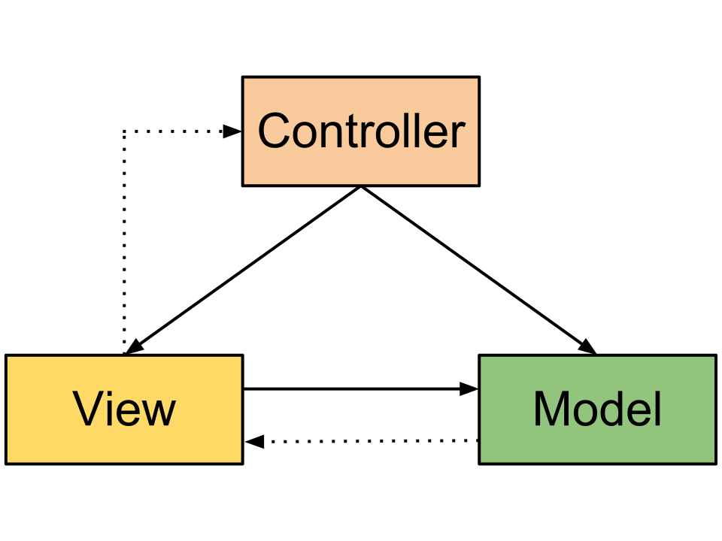
Component Interactions
Notes:
这里可能会不同，这只是其中一种交互方式。

Slide 30
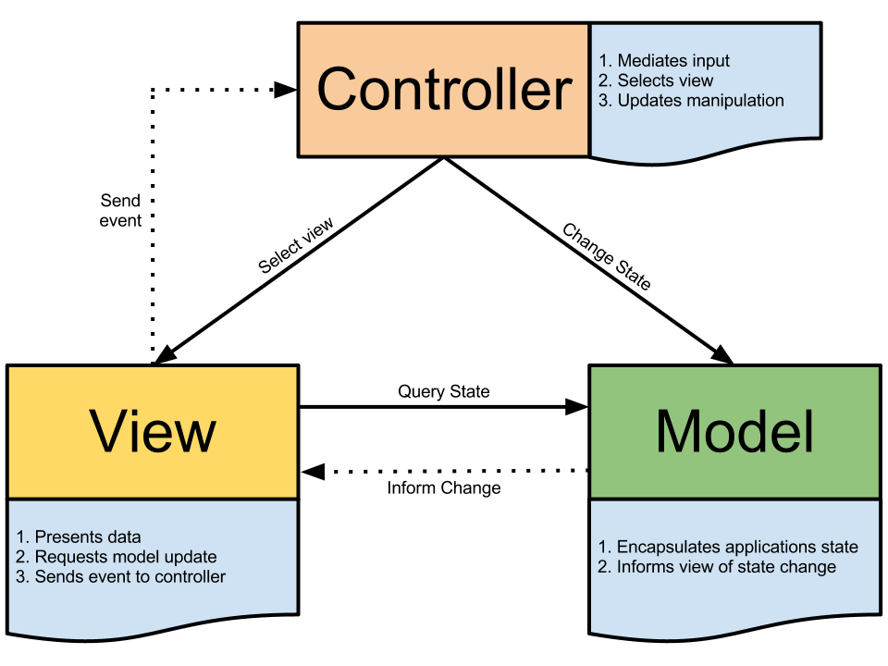
Component Interactions(cont’d)
Notes:
这里可能会不同，这只是其中一种交互方式。

Slide 31
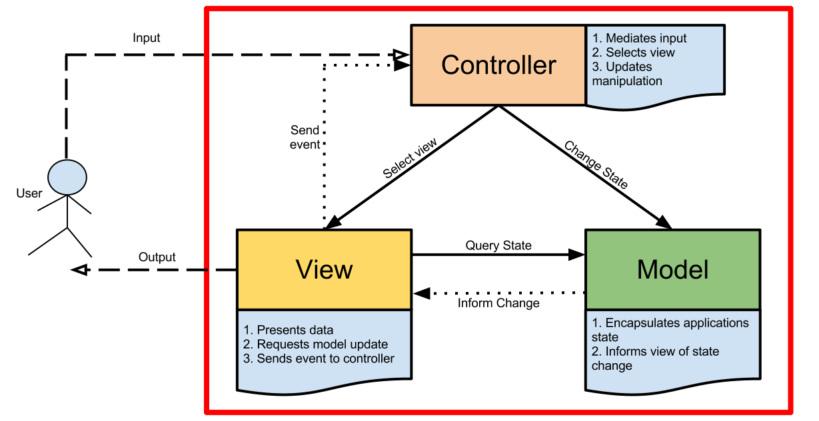
Component Interactions(cont’d)
Notes:
这里可能会不同，这只是其中一种交互方式。

Slide 32
Component Interactions(cont’d)
A model notifies its associated views and controllers when there has been a change in its state.
A view requests from the model the information that it needs to generate an output representation.
A controller can send commands to its associated view to change the view's presentation of the model.
Notes:
在Classic MVC中，Controller可以改变Model的状态，View可以查询Model的状态，所以说对Model而言，Controller和View的地位是平等的，不过在Web MVC中，Controller变成了中继者，主要工作是协调Model和View，如此看来，Web MVC中的Controller等同于MVP中的Presenter。那为什么不叫Web MVP，而称之为Web MVC？这是因为截获请求的是Controller而不是View。

Slide 33
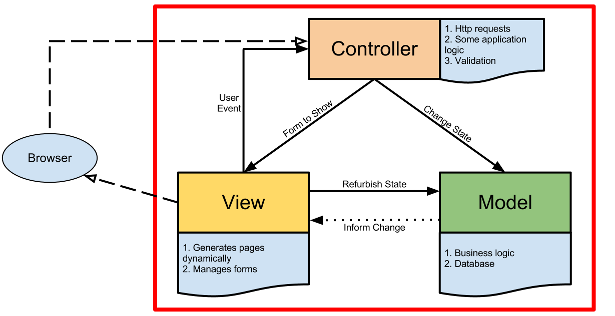
MVC in Web Application

Slide 34
MVC in Web Application(cont’d)
Standard MVC | MVC in Web(Ruby on Rails)
Model | Model + Controller
View | View
Controller | Allocator + Controller(part)

Slide 35
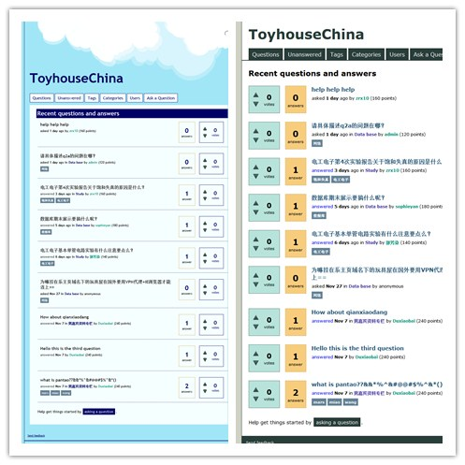
Example: Question2Answer

Slide 36
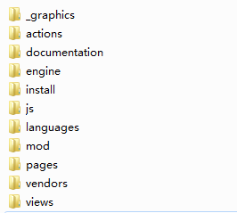
Example: Elgg

Slide 37
Why use MVC?

Slide 38
Merits
Separation of view from model
Separation of controller from view
Easy to change view
A model corresponding to multiple views
Multiple views can respond
Easy to test
Notes:
银行的帐户的商务逻辑层对应ATM和Internet两个显示层

Slide 39
Demerits
Complexity
Strong correlation
Hard to understand

Slide 40
MVC frameworks
Almost any programming language
Slightly different from each other
Reduce complexity

Slide 41
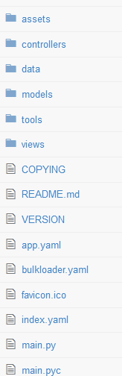
Example: Google Course Builder

Slide 42
Combining
The architecture of a software system is almost never limited to a single architecture pattern, but is often a combination of architecture patterns that make up the complete system.

Slide 43
Workflow-oriented Architecture
A combination of SOA, MVC and Client/Server architecture pattern.

Slide 44
Architecture Pattern
An Architecture pattern is a concept that solves and delineates some essential cohesive elements of a software architecture.
Not an architecture.
Strictly described and commonly available.
Notes:
Even though an Architecture pattern conveys an image of a system, it is not an architecture.
An Architecture pattern is a concept that solves and delineates some essential cohesive elements of a software architecture. Countless different architectures may implement the same pattern and share the related characteristics. Patterns are often defined as "strictly described and commonly available“. For example, the layered architecture is a call-and-return style because it defines an overall style to interact. When it is strictly described and commonly available, it is a pattern.

Slide 45
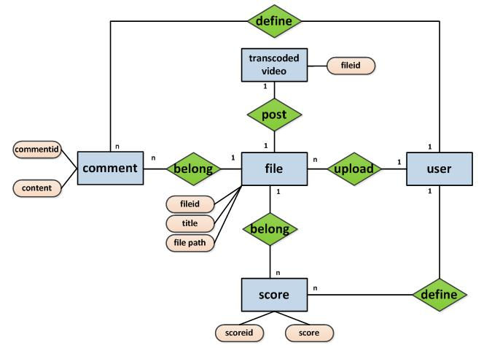
Media ER model

Slide 46
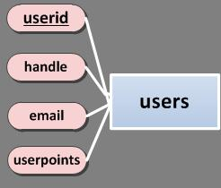
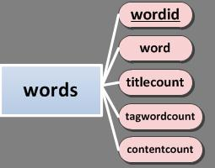

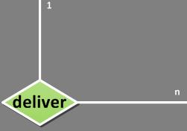
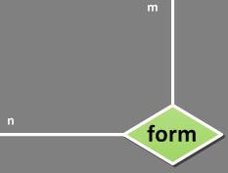

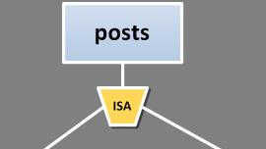
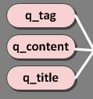



Q&A extended ER model

Slide 47



SNS river model
Wiki
L-MANA
Media
UAM
UI
Simplified design
Standard design
Reservoir
Q&A
Notes:
河变宽了，更多鱼进来了，水太多，信息量太大，需要search组帮忙查找讯息。另外可以组建小组，分流信息。

Slide 48
Architecture Description Language
Concept
In the system engineering community, an ADL is a language and/or conceptual model used to describe and represent system architectures.

Slide 49
Architecture Description Language
Function
With box-and-line drawing, it can effectively demonstrate components, properties, semantics of connections and overall system architecture.
Representative
ACME, ADML, CMU, Petri net, UML (controversial)

Slide 50
Petri Net
Concept
The petri net is one of several mathematical modeling languages for the description of distributed systems

Slide 51
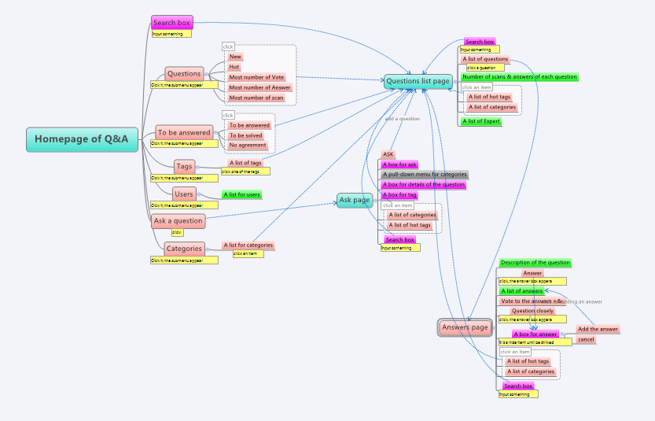

Slide 52
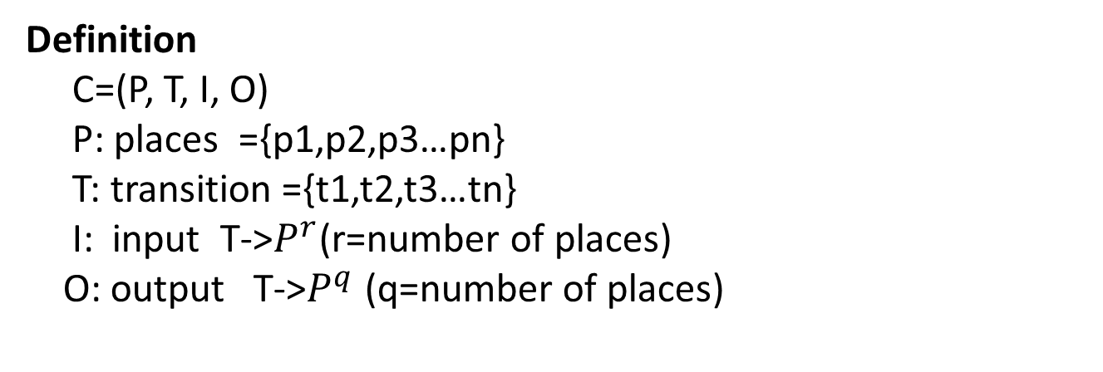
Petri Net
Definition
C=(P, T, I, O)
P: places ={p1,p2,p3…pn}
T: transition ={t1,t2,t3…tn}
I: input T->$P^{r}$(r=number of places)
O: output T->$P^{q}$ (q=number of places)

Slide 53
Petri Net
Basic
two kinds of nodes: places and transitions, represented respectively with circle and bars
arc existing only from places to transitions and vice versa
tokens represented with dots
p1
p2
t1

Slide 54
Petri Net
Property
Synchronization : t1 can be ready to fire only when there’s at least one token at each of its input places
t1

Slide 55
Petri Net
Property
Merging: when tokens from several places arrive at the same transition, the tokens merge into a whole
t1

Slide 56
Conflict
in the following model
The problem can be solved in a probabilistic way:
P(t1)=0.4
P(t2)=0.6

Slide 57
Examples
Our workflow unit
user
UAM: register
learner
Search
post
Results arranged
Media found
Q&A/wiki: data found
standardize
UI: display
learning
SNS: publish
UI: display
Results seen
River: learning information published
Another learning unit

Slide 58


Our project
controller
Put up a project
Project published on github
$P_{11}$carry out
$P_{22}$carry out
……
continue
Product1 finished
Product4 finished
Merge 1
Merge 2
Products merged + reputation given
discarded
discarded
take record
Achievements published on DPC

Slide 59
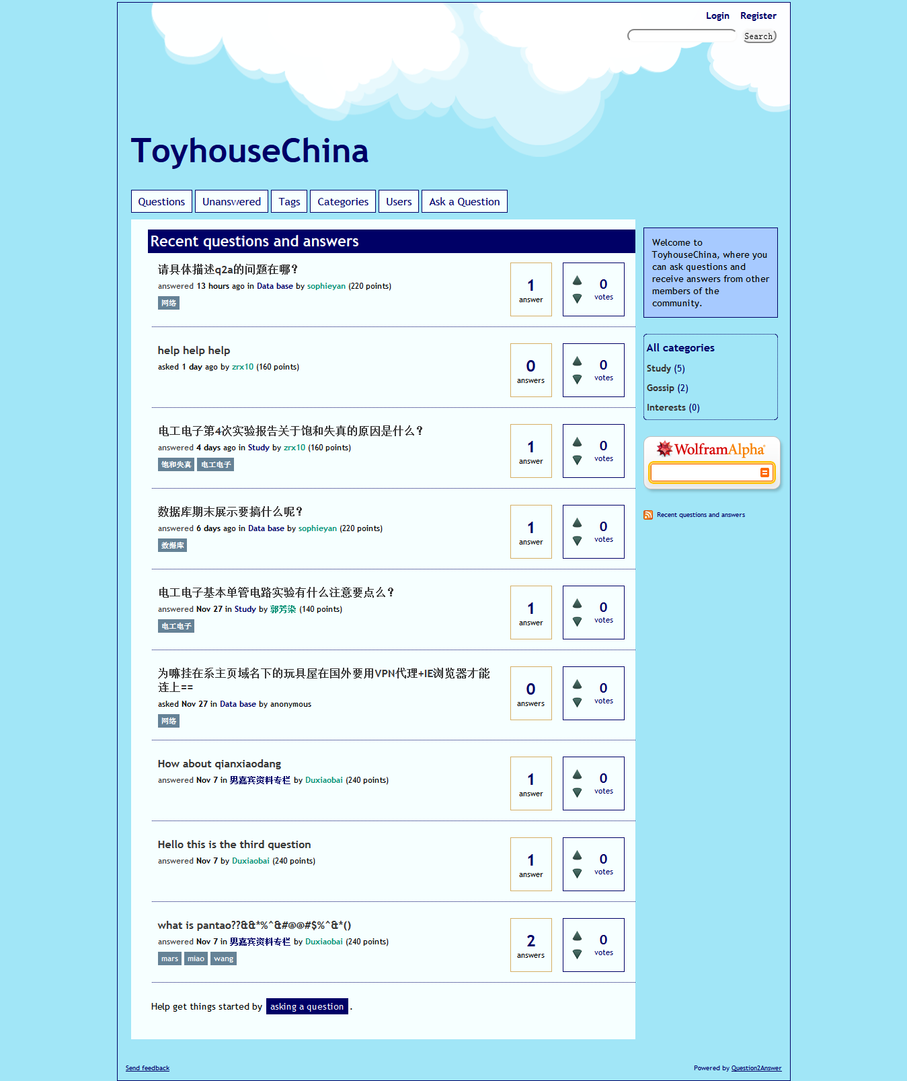
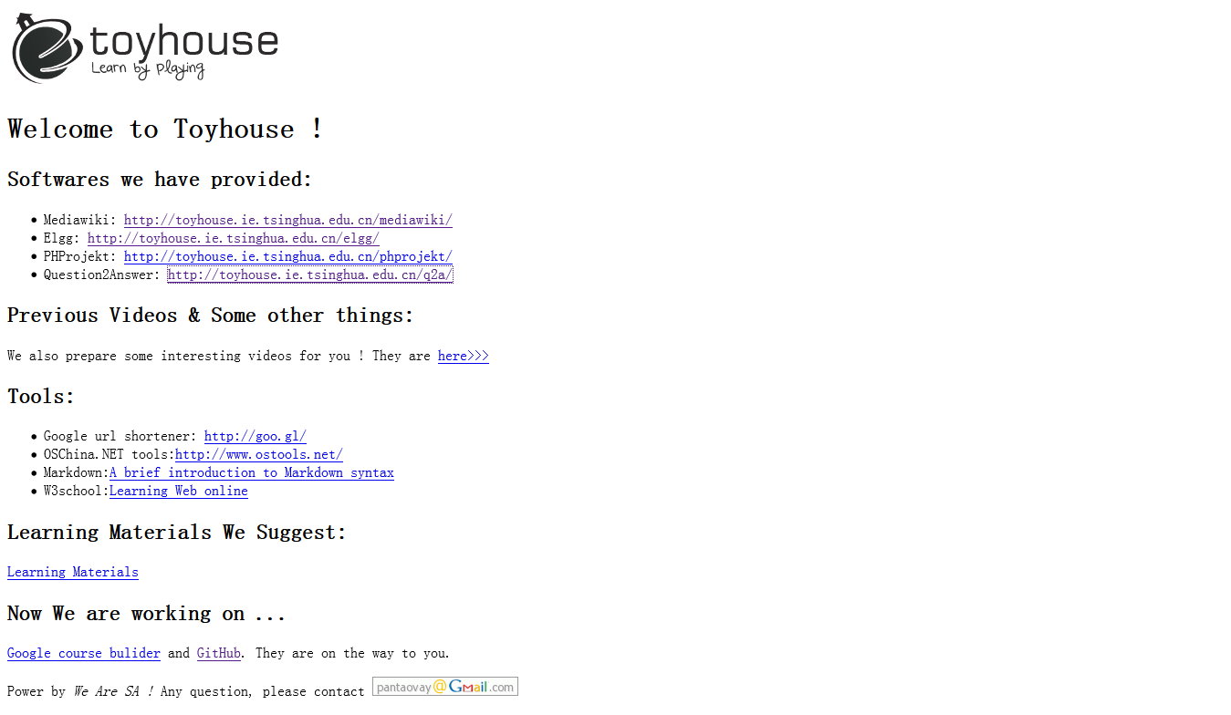
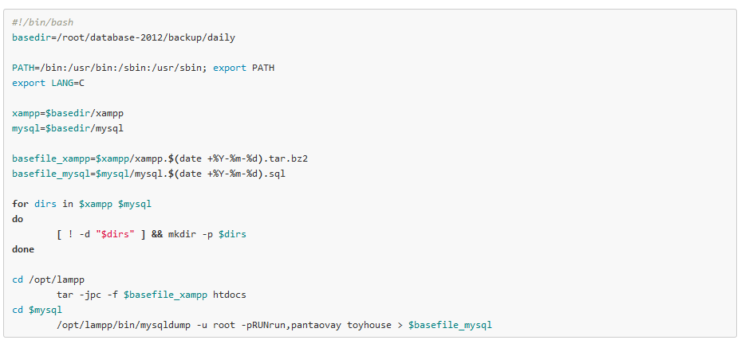

Conclusion
Designing
Implementing
Deploying
Testing
Maintaining
Notes:
As System Architect or Software Architect, we concentrate on the whole life cycle of a software, on the workflow of it and designing in particular. As regards implementing, this is what you guys on doing through this semester. When a software is finished developing, we will deploy it to the server and test the software. This doesn’t mean that we don’t test while implementing, they focus on different areas. One is large-scale test, and the other is code segment test. And I have seen that MEMa team has done a lot of tests on their code. Hello, WenXin, isn’t it? Maintaining is the routine work after software release. Because we will find bugs, add functions, modify views etc. So, this is the life cycle of a software. And we start our project with designing. And I say designing, I have to mention architecture. Ok, what is software architecture then?

Slide 60
Architecture is a process not a result and we enjoy the process of leading the world.

Slide 61
Thanks to:
Mr. Koo
Yelong Liqian
And all the listeners!

